Slide 1



Mapping Financial Services Uganda
Eastern Region and Kampala
© HOT Tanzania & Uganda: Ketty Adoch, Mhairi O’Hara, Geoffrey Kateregga, Douglas Ssebaggala, Paul Uithol

Slide 2
Outline
Project Introduction
Open data
OpenStreetMap
Navigation
Contributing
Sharing data

Slide 3
Crowdsourcing Financial Service Locations (Pilot Program) - Mapping Financial Access Points.
Project Introduction

Slide 4
Collecting financial service locations has been challenging....
High cost
Risk of stale data
Model not self-sustaining
Hard to scale-up to larger areas
Lost opportunities for entrepreneurship
Notes:
Has been challenging

Slide 5
Pilot Project - HOT in Partnership with FSD Uganda
Goals:
Strengthen and expand local open data & mapping ecosystem
Collect and map comprehensive financial service point data
Assess cost, quality, and sustainability of crowdsourcing
Time period: 6 months
When: January 2016 through March 2016 (Core Activities)
Where: 15-20 districts across Uganda

Slide 6
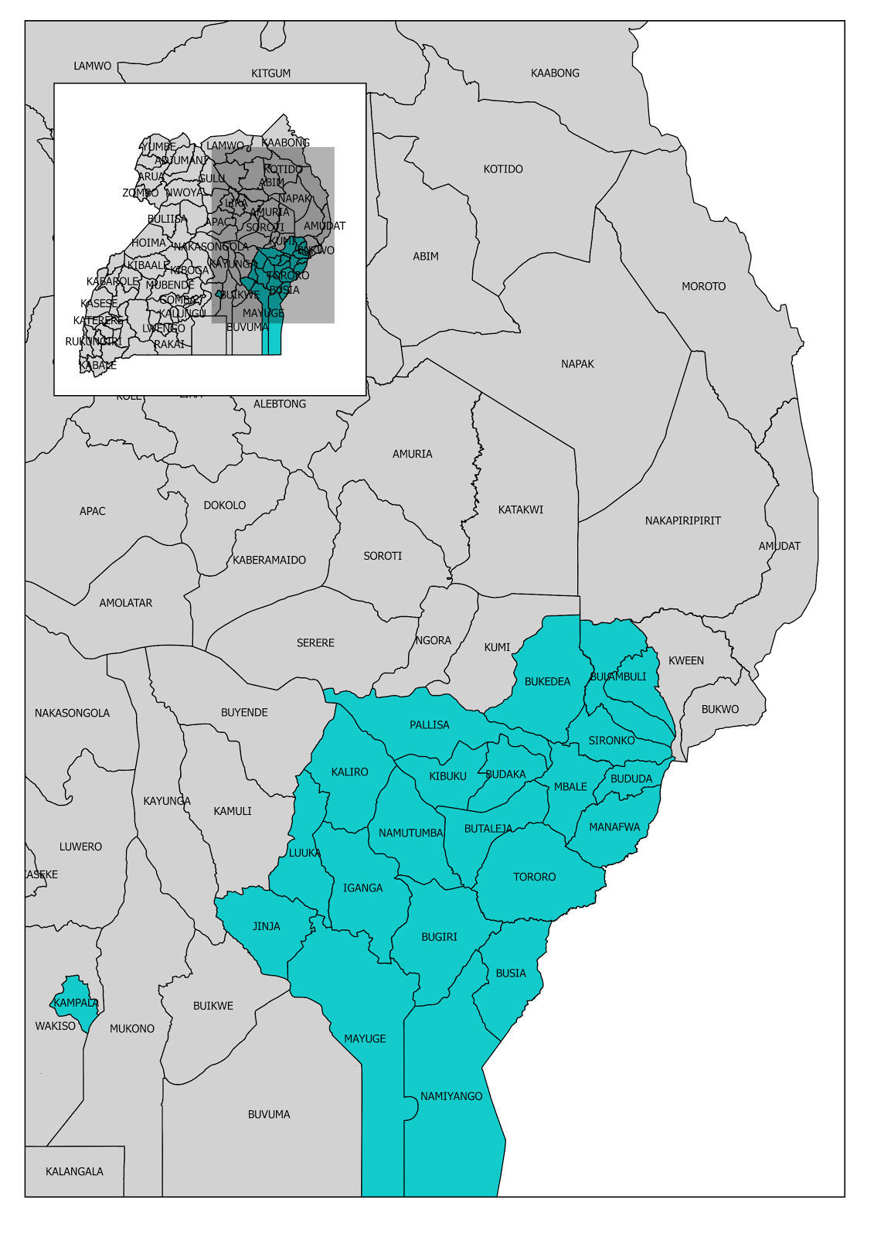
Where: Proposed districts to map
Based on a mix of rural/urban districts;
Urban:
Mbale
Tororo
Jinja
Kampala
Mbale | Tororo | Jinja | Kampala
Sironko Bududa Manafwa Bulambuli Kapchorwa Bukedea Pallisa Kibuku Budaka | Butaleja Namutumba Bugiri Namiyango Busia | Kaliro Luuka Iganga Mayuge

Slide 7
Who: Stakeholders and Partners
Key stakeholders
Gates Foundation
FSD Uganda
Bank of Uganda
UBOS
Makerere University
Others:
Outbox
Universities in Eastern Uganda
Other Universities in Kampala

Slide 8
How: General approach
Identify key stakeholders & communities
Build and train 3 groups, each consisting of:
1 supervisor
3 mapping teams; 2 to 3 team members, 1 team lead
(so around 10 to 13 persons total)
Team members are the students/volunteers per visited district.
Use bodaboda’s, rent cars/taxis
Mobile money agents’ collaboration
Seasonal and General elections breaks

Slide 9
Outline
Project Introduction
Open data
OpenStreetMap
Navigation
Contributing
Sharing data

Slide 10
Open data
Data is open if..
Access
Redistribution
Re-use
Absence of Technological Restriction
Attribution
http://www.opendefinition.org/okd/
http://opendatatoolkit.worldbank.org/en/index.html

Slide 11
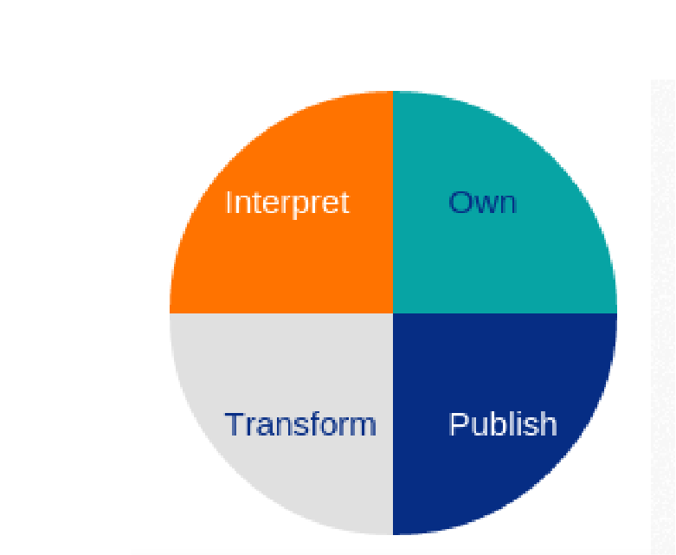
The Wheel of Open Data…….

Slide 12
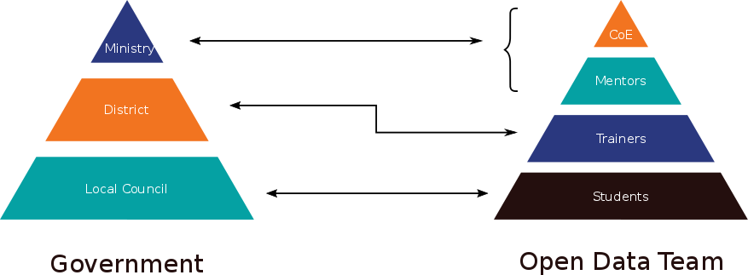
Towards an Open Government

Slide 13

OpenStreetMap
Open Data
OpenStreetMap is open data: you are free to use it for any purpose as long as you credit OpenStreetMap and its contributors.
Collaborative project to create a free editable world map

Slide 14
How does it work?
Local Knowledge
Community Driven
Inspired by the success of Wikipedia
Built by a community of mappers that contribute and maintain data about roads, trails, cafés, railway stations, and much more, all over the world.

Slide 15
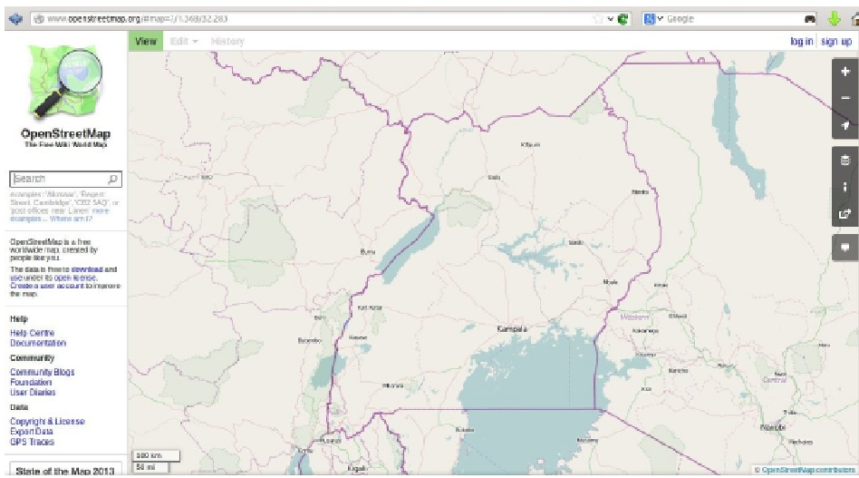
Local knowledge
Contributors use aerial imagery, GPS devices, and low-tech field maps to verify that OSM is accurate and up to date.

Slide 16
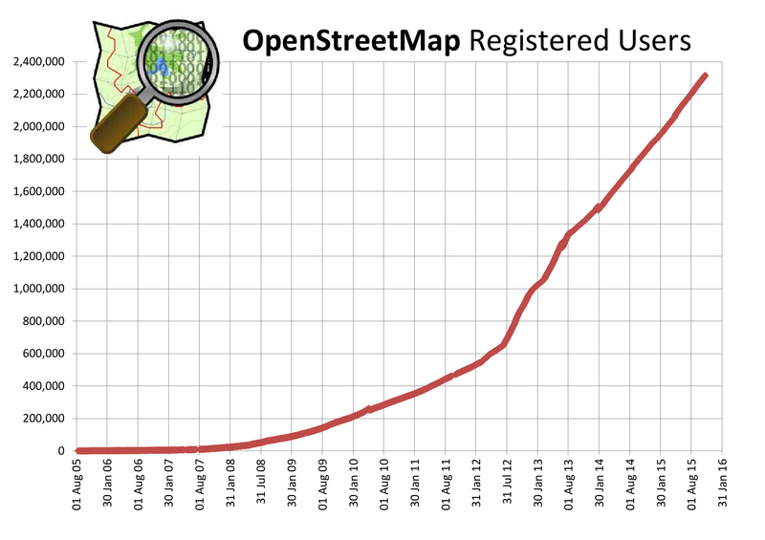
Community
http://wiki.openstreetmap.org/wiki/Stats

Slide 17
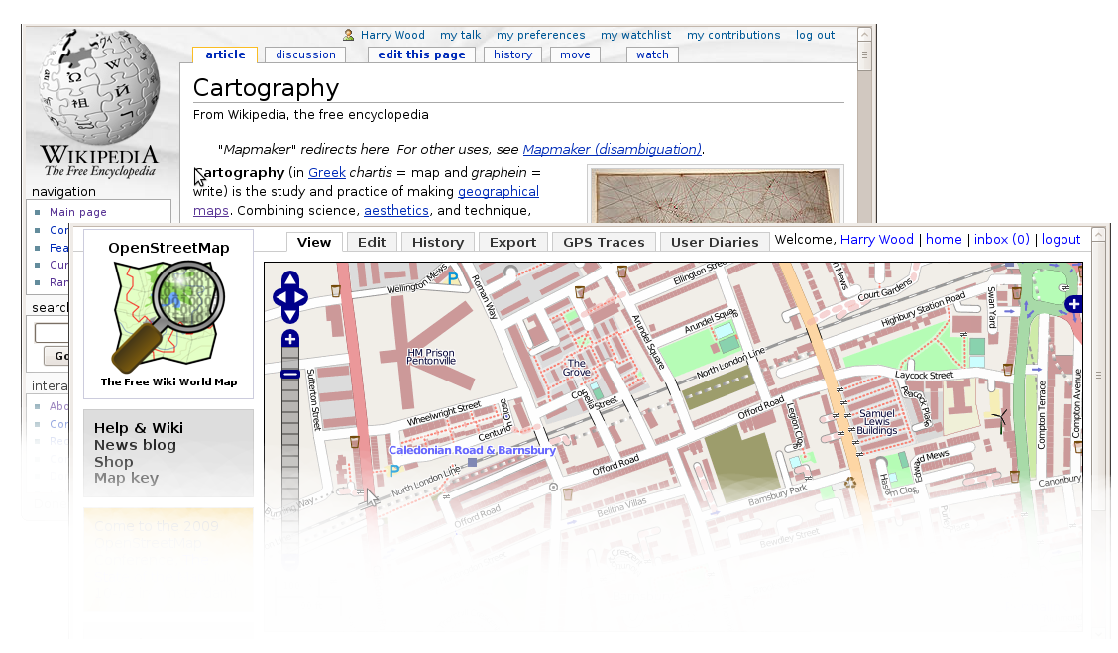
Wikipedia of Maps

Slide 18
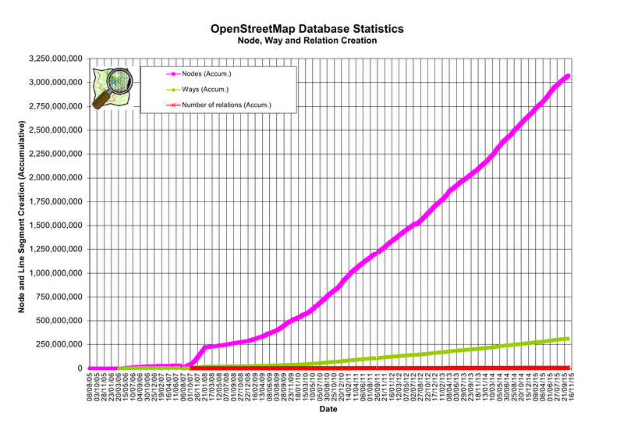
Data objects
http://wiki.openstreetmap.org/wiki/Stats

Slide 19
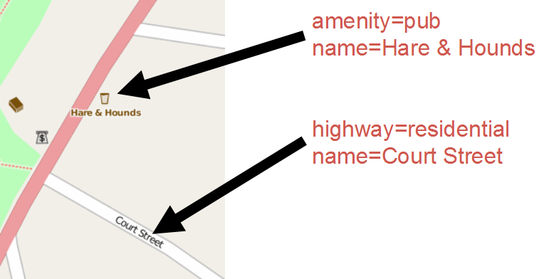
The data
All Vector Data
Free-tagging system
(meaning every object in the database can carry an unlimited number of attributes)

Slide 20
What can OSM be used for?
Anything…
Humanitarian
Planning / Preparation
Communicating Issues / Problems
Business

Slide 21
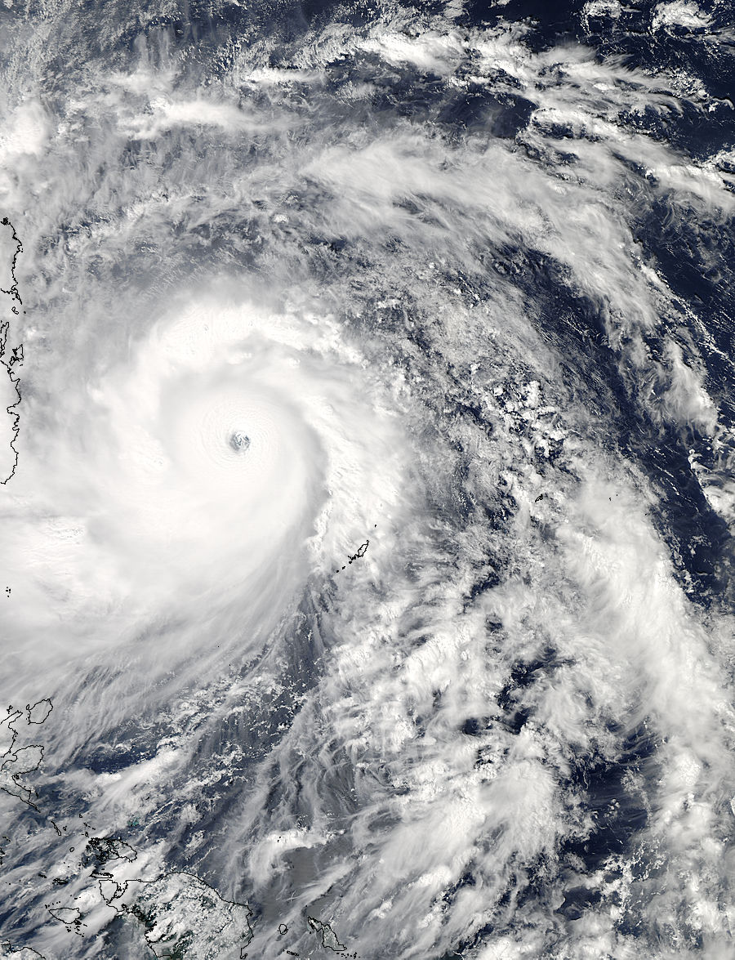
Humanitarian

Slide 22
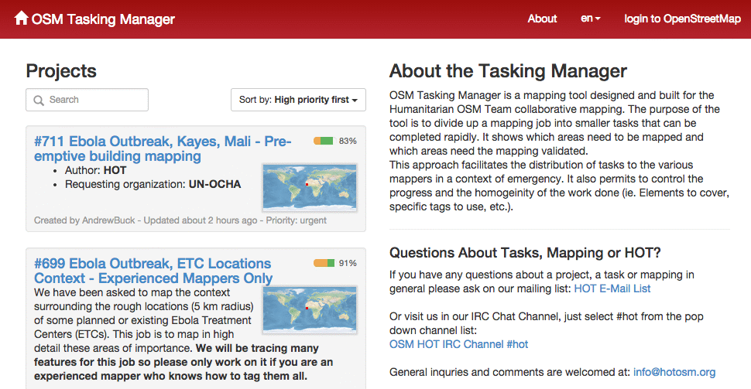
Humanitarian

Slide 23
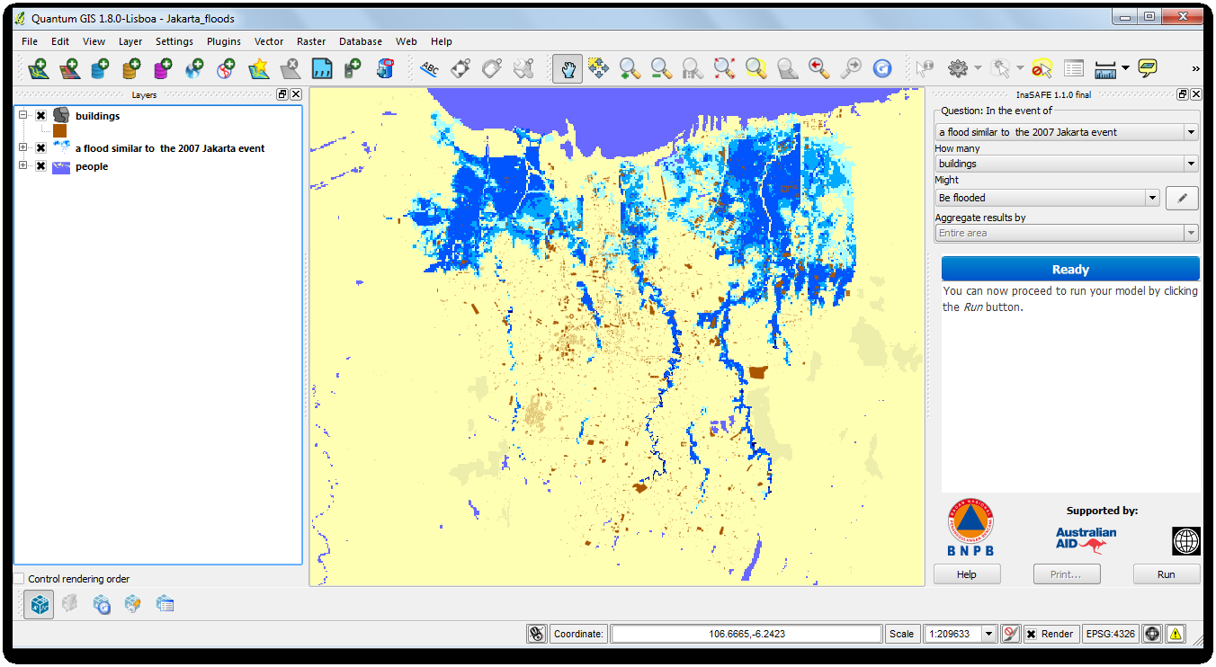
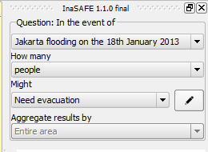
Preparation/planning

Slide 24
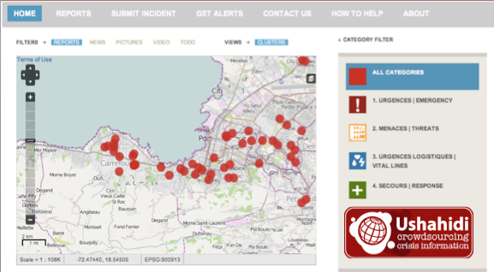
Communicating issues/problems

Slide 25
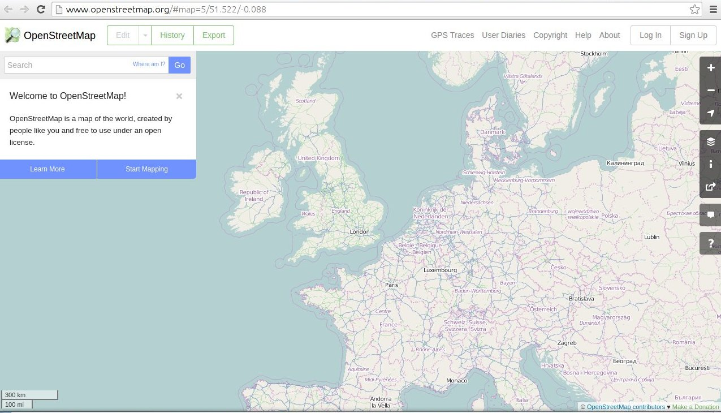
Navigating the map
Left mouse to drag the map
Mouse wheel to zoom

Slide 26
Contributing
Go to https://www.openstreetmap.org/user/new
Fill in email address, username, and password
Remember your password!
Yahoo mail can sometimes cause issues with the confirmation email. Use gmail if possible.
Find the confirmation email, click the link to confirm
Log in

Slide 27
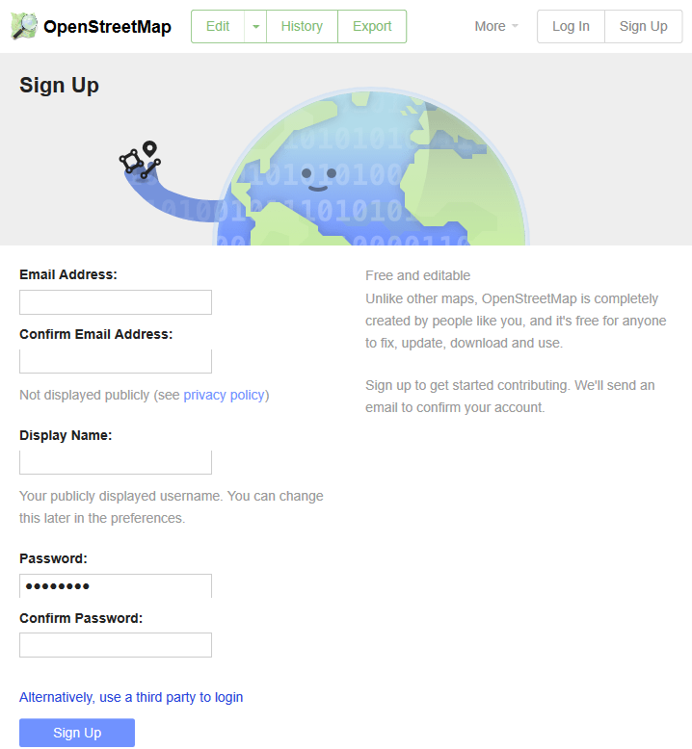

Slide 28
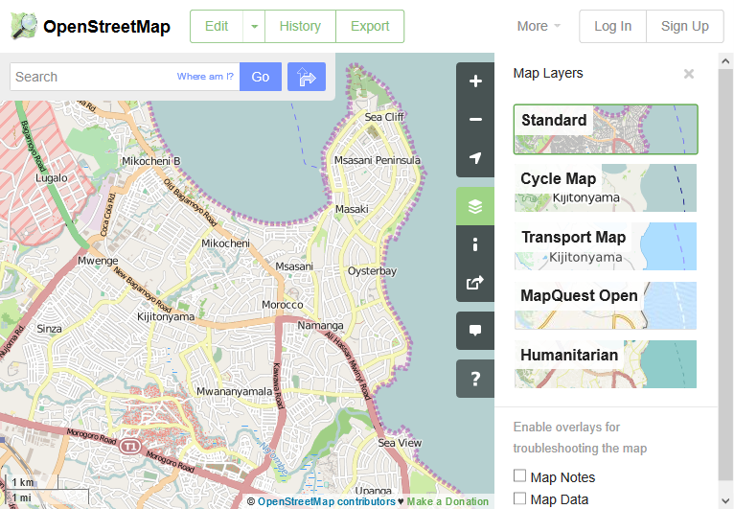
Map layers (Rendering)

Slide 29
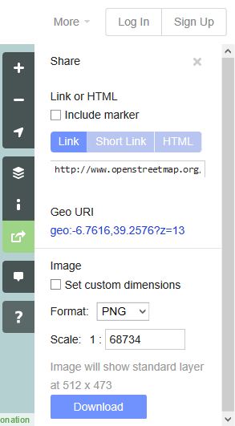
Share and sample download

Slide 30
Outline
Project Introduction
Open data
OpenStreetMap
Navigation
Contributing
Sharing data

